Slide 1
Monocular Estimation of
Spatial Displacement

Slide 2
Profile
2004: Bachelor in Computer Science, UFES
2004: Software developer at Mogai
2008: Software Engineer at LG Electronics
2010: Master in Computer Intelligence, UFES
2013 (Apr): Admitted to Brazilian scholarship program “Ciencia sem Fonteiras” (“Science without Borders”)
2013 (Oct): Started PhD course, University of Tsukuba
Present: Working on thesis project, applications of Weightless Neural Networks to robot localization problems

Slide 3
Introduction
Displacement Estimation Model
Statistical Analysis
Conclusions
Further Research

Slide 4
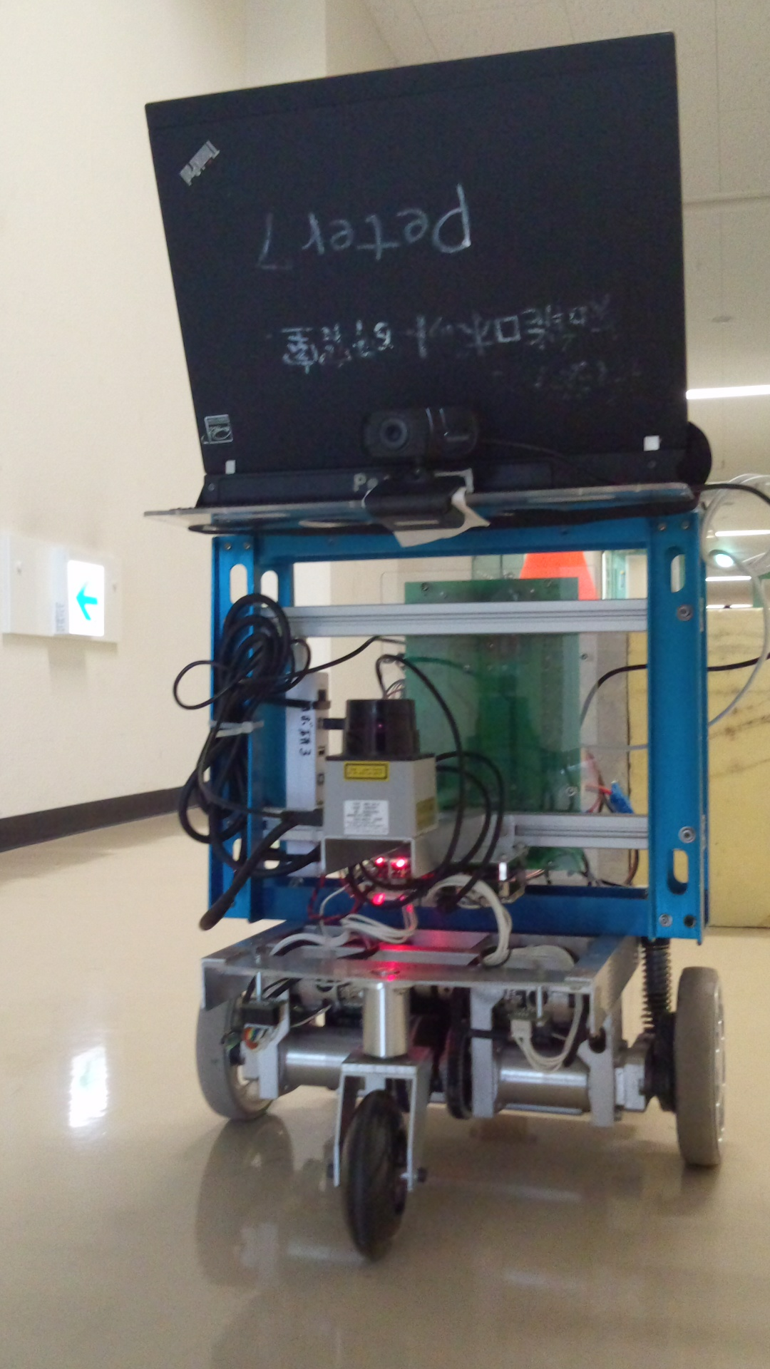
Displacement Estimation Model
Robot equipped with monocular camera and odometer

Slide 5
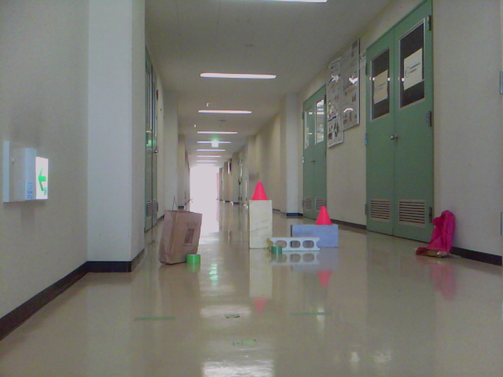
Displacement Estimation Model
Environment contains stationary objects, or landmarks

Slide 6
Displacement Estimation Model
As robot moves about, images of landmarks change
Change patterns depend on the mode of movement from one picture to the next
  Straight
  Sideways
  Turning

Slide 7
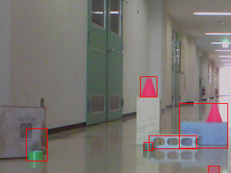
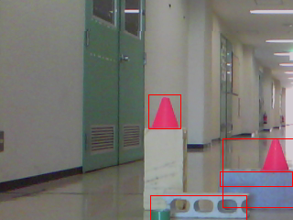
Displacement Estimation Model
Straight (forward) movement
  Landmarks appear bigger as they get close

Slide 8
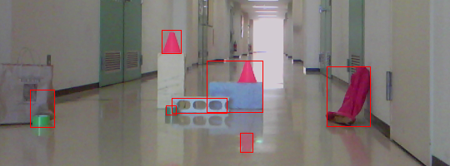
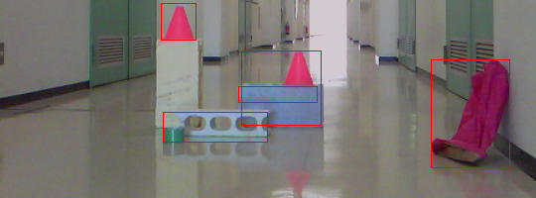
Displacement Estimation Model
Straight (forward) movement
  Landmarks drift towards image borders

Slide 9
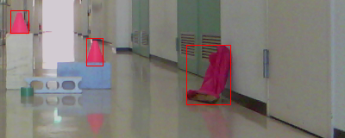
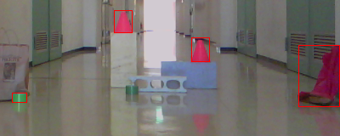
Displacement Estimation Model
Turning movements
  Landmarks slide horizontally across the image
  Size and relative position remain largely the same

Slide 10
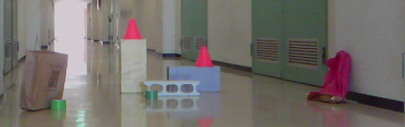
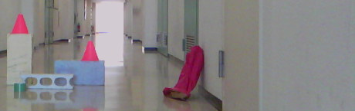
Displacement Estimation Model
Sideways movements
  Landmarks slide horizontally across the image
  Size and relative position remain largely the same
  Overlapping objects move relative to each other

Slide 11
Displacement Estimation Model
Change in landmark sightings between robot movements can be represented as changes to four attributes:
  Width
  Height
  Horizontal position
  Vertical position
Property changes can be absolute or relative

Slide 12
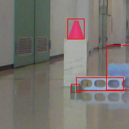
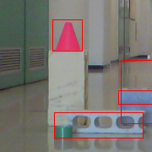
Displacement Estimation Model
Absolute: changes to same landmark across two images
(x1, y1, θ1)
(x2, y2, θ2)
(u1, v1)
(u2, v2)
h1
h2
w1
w2

Slide 13
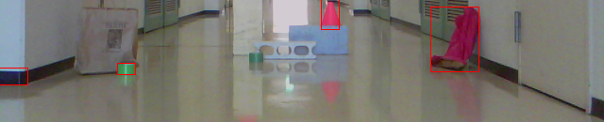
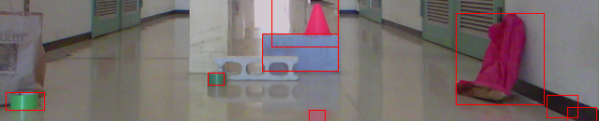
Displacement Estimation Model
Relative: changes to pair of landmarks across two images
(u'1, v'1)
(x1, y1, θ1)
(u1, v1)
h'1
h1
w1
w'1
(u'2, v'2)
(x2, y2, θ2)
h'2
(u2, v2)
h2
w'2
w2

Slide 14
Displacement Estimation Model
Pictures can be described in terms of landmark sightings

Slide 15
Displacement Estimation Model
Locate landmarks in picture

Slide 16

Displacement Estimation Model
Separate landmarks from background

Slide 17

Displacement Estimation Model
Tag landmark images with image-centric size and position data
L2
(w, h, u, v)
L3
(w, h, u, v)
L4
(w, h, u, v)
L1
(w, h, u, v)

Slide 18
Displacement Estimation Model
Create a scene as a collection of tagged landmarks
si
L2
(w, h, u, v)
L3
(w, h, u, v)
L4
(w, h, u, v)
L1
(w, h, u, v)

Slide 19
Displacement Estimation Model
Associate the robot's coordinates at the time the original picture was taken to the scene as its position
si
pi = (xi, yi, θi)
L2
(w, h, u, v)
L3
(w, h, u, v)
L4
(w, h, u, v)
L1
(w, h, u, v)

Slide 20
Displacement Estimation Model
The difference between two scenes si and sj is the set of absolute and relative changes to their common landmarks
Dij
Si
Sj
Li1
-
Lj1
= (Δw, Δh, Δu, Δv)1
Li1
Li2
...
Liz
-
Lj1
Lj2
...
Ljz
=
Li2
-
Lj2
= (Δw, Δh, Δu, Δv)2
...
...
pi
pj
Liz
-
Ljz
= (Δw, Δh, Δu, Δv)z

Slide 21
Displacement Estimation Model
The displacement is the change between their positions
Dij
Si
Sj
Li1
-
Lj1
= (Δw, Δh, Δu, Δv)1
Li1
Li2
...
Liz
-
Lj1
Lj2
...
Ljz
=
Li2
-
Lj2
= (Δw, Δh, Δu, Δv)2
...
...
pi
pj
Liz
-
Ljz
= (Δw, Δh, Δu, Δv)z
pi - pj = (Δx, Δy, Δθ)

Slide 22
Displacement Estimation Model
The mode is the form of movement (straight, sideways or turning) employed going from one position to the other
Dij
Si
Sj
Li1
-
Lj1
= (Δw, Δh, Δu, Δv)1
Li1
Li2
...
Liz
-
Lj1
Lj2
...
Ljz
=
Li2
-
Lj2
= (Δw, Δh, Δu, Δv)2
...
...
pi
pj
Liz
-
Ljz
= (Δw, Δh, Δu, Δv)z
pi - pj = (Δx, Δy, Δθ)
(F|T|S)

Slide 23
Displacement Estimation Model
Given a difference between a reference scene si for which pi is known, and a query scene sj, can pj be derived?
Dij
Si
Sj
Li1
-
Lj1
= (Δw, Δh, Δu, Δv)1
Li1
Li2
...
Liz
-
Lj1
Lj2
...
Ljz
=
Li2
-
Lj2
= (Δw, Δh, Δu, Δv)2
...
...
pi
pj
pj ?
Liz
-
Ljz
= (Δw, Δh, Δu, Δv)z
pi - pj = (Δx, Δy, Δθ)
(F|T|S)

Slide 24
Statistical Analysis
Recorded data: 1300 images of test landmarks
Grid of 10 x 10 stops, 10cm apart
13 takes at each stop, 10º apart

Slide 25
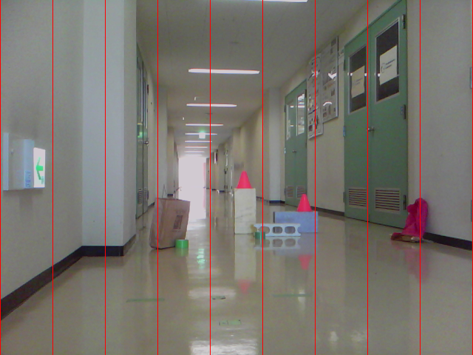
Statistical Analysis
Separate field of view in 9 vertical bands
Group changes by band of first landmark sighting

Slide 26
Statistical Analysis
Absolute differences
  Straight movements: 10cm increments forward
  Sideways movements: 10cm increments left-to-right
  Turning movements: 10° increments clockwise
Band-wise robot displacement X average change
  Width
  Height
  Horizontal position (U)
  Vertical position (V)

Slide 27
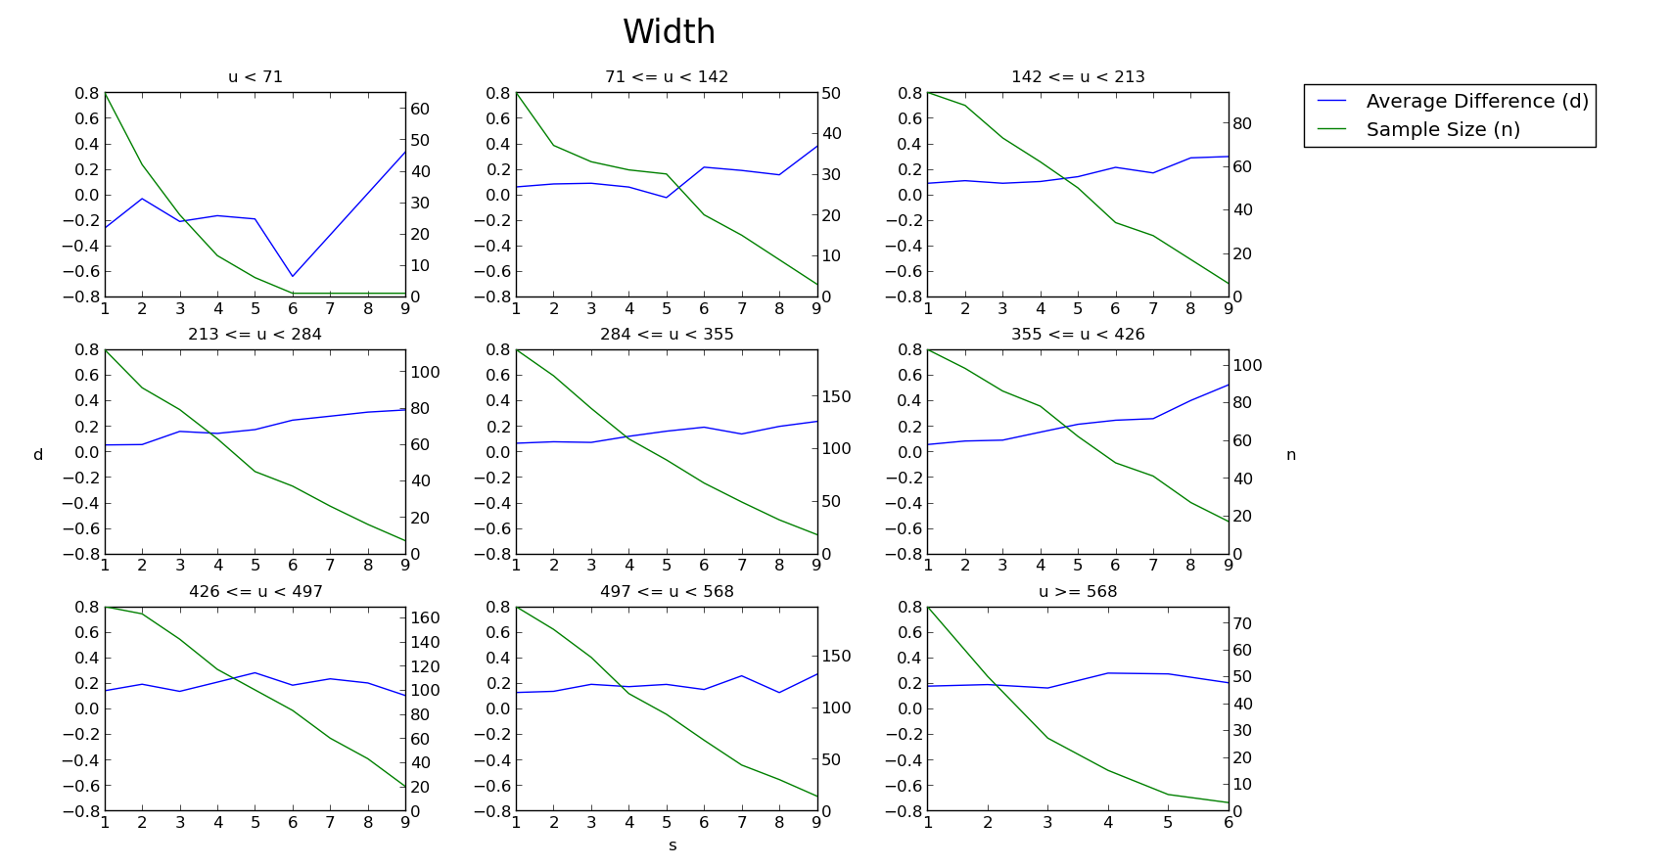
Statistical Analysis
Straight movements

Slide 28
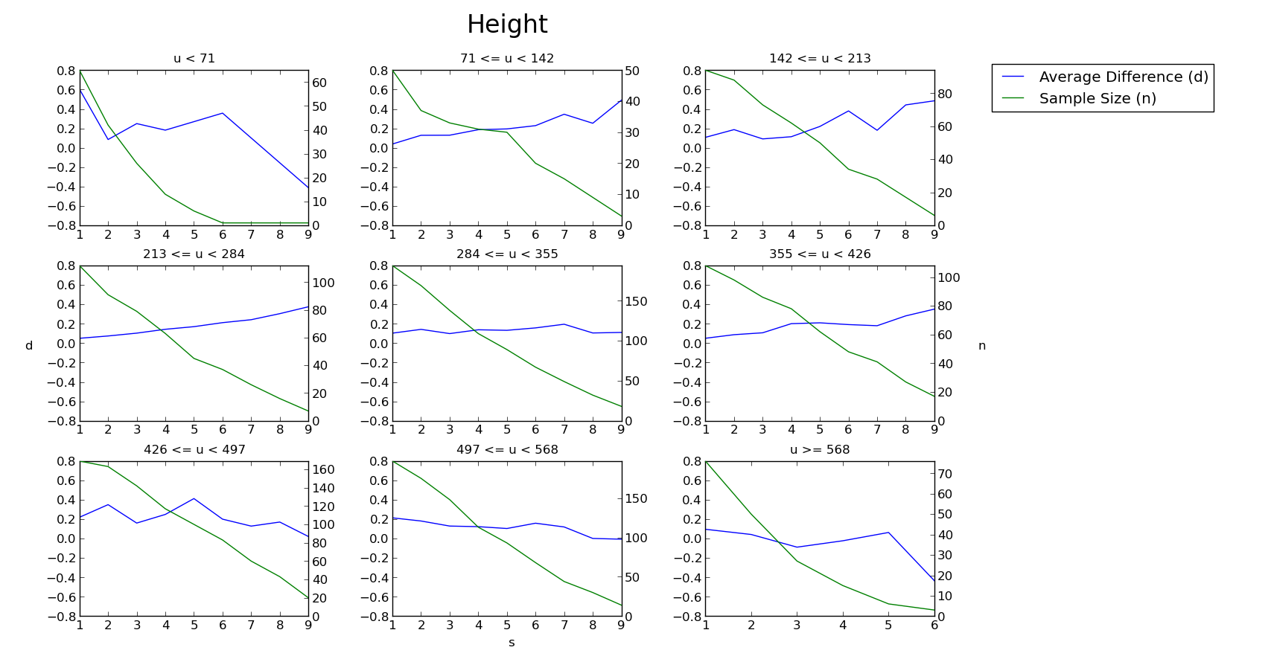
Statistical Analysis
Straight movements

Slide 29
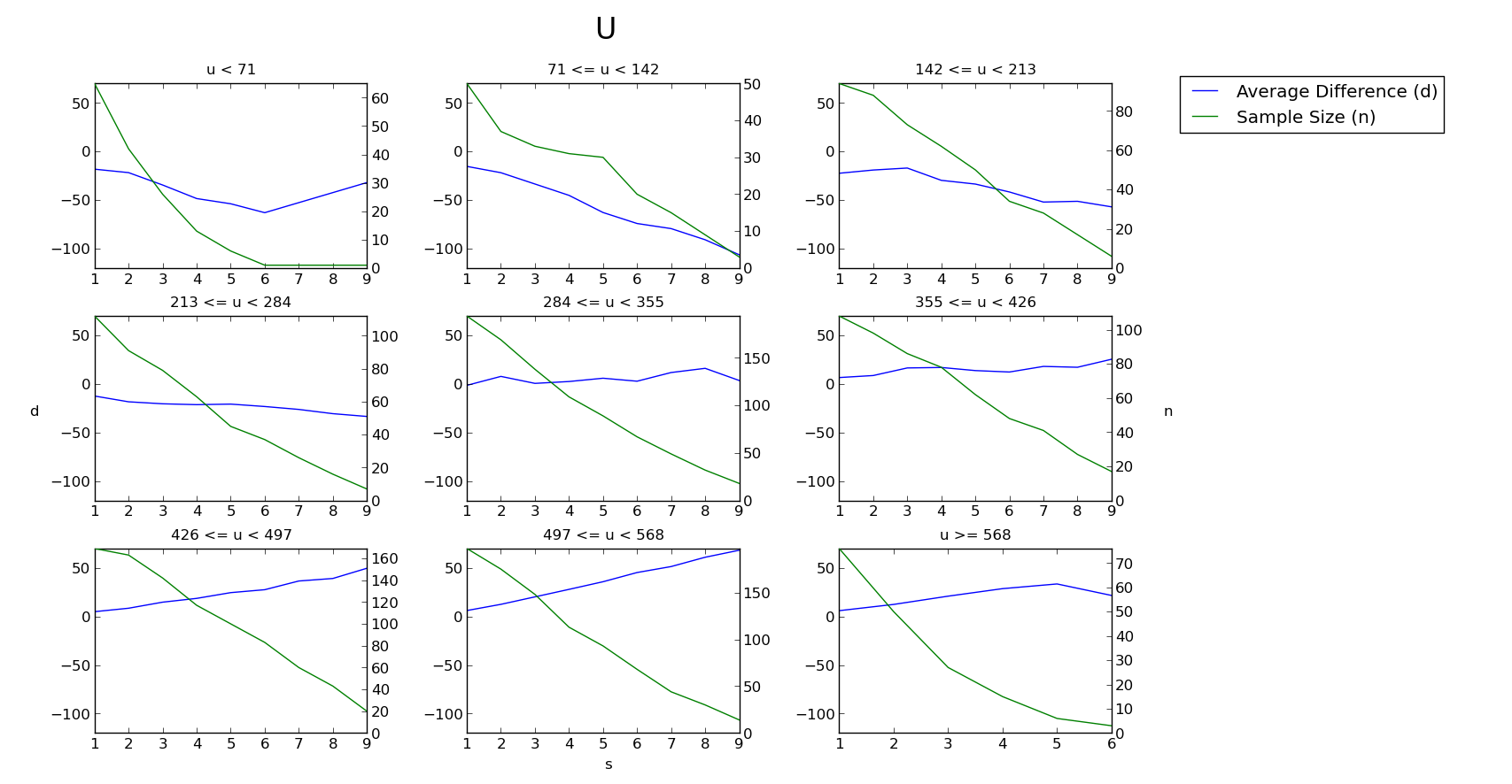
Statistical Analysis
Straight movements

Slide 30
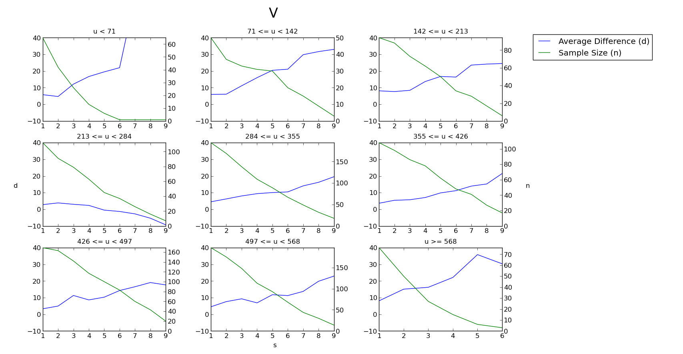
Statistical Analysis
Straight movements

Slide 31
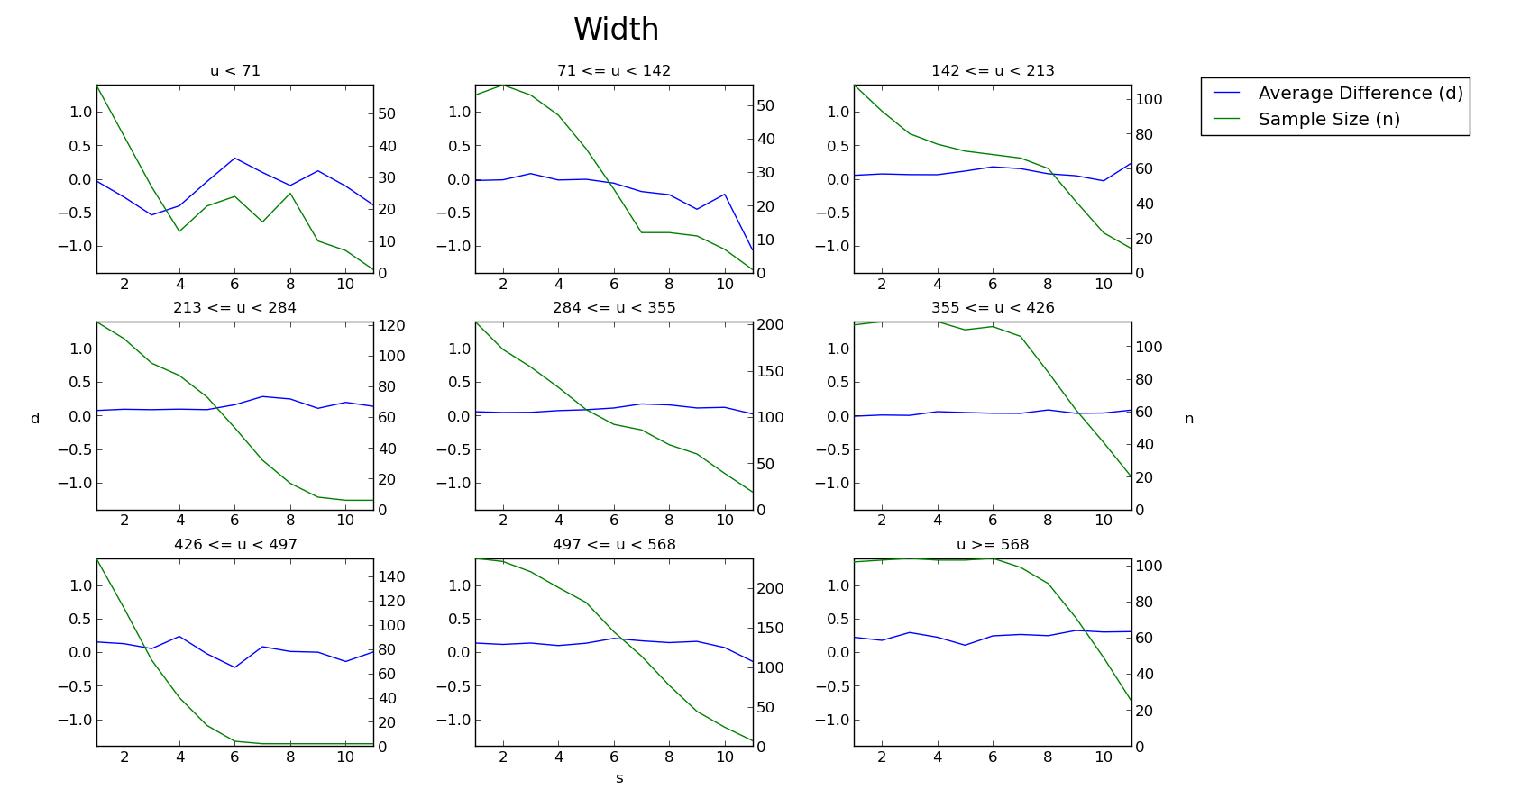
Statistical Analysis
Sideways movements

Slide 32
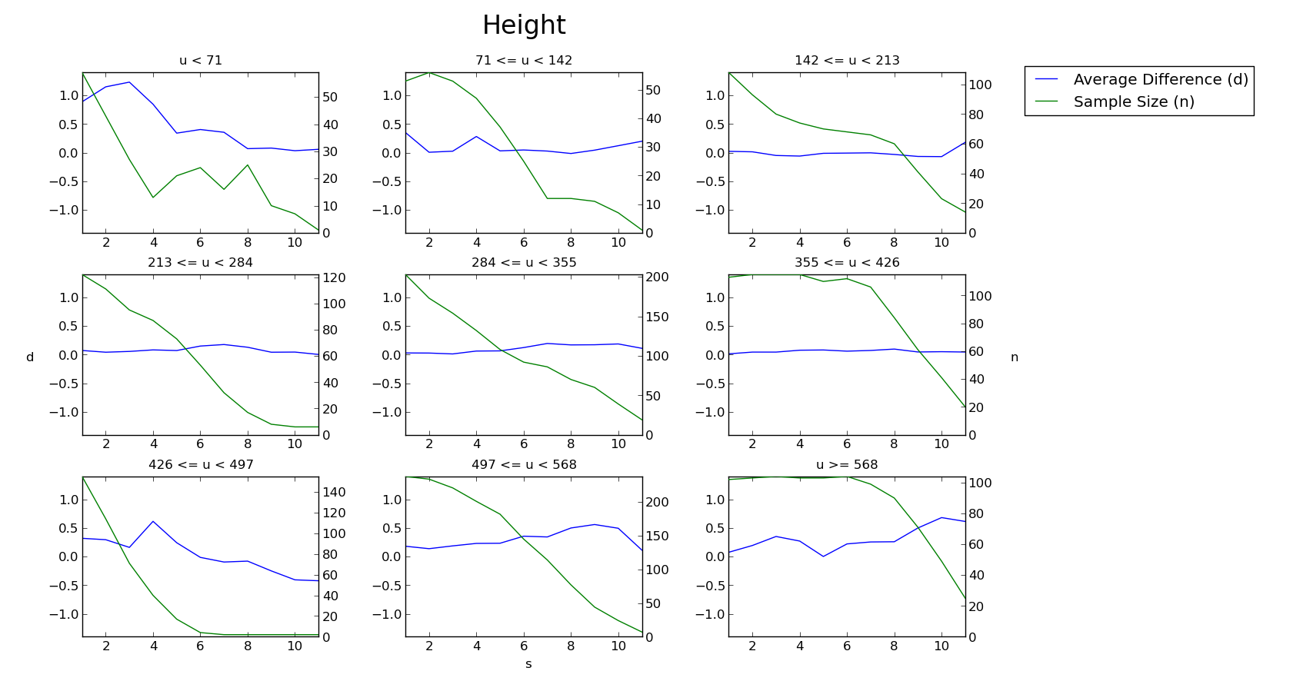
Statistical Analysis
Sideways movements

Slide 33
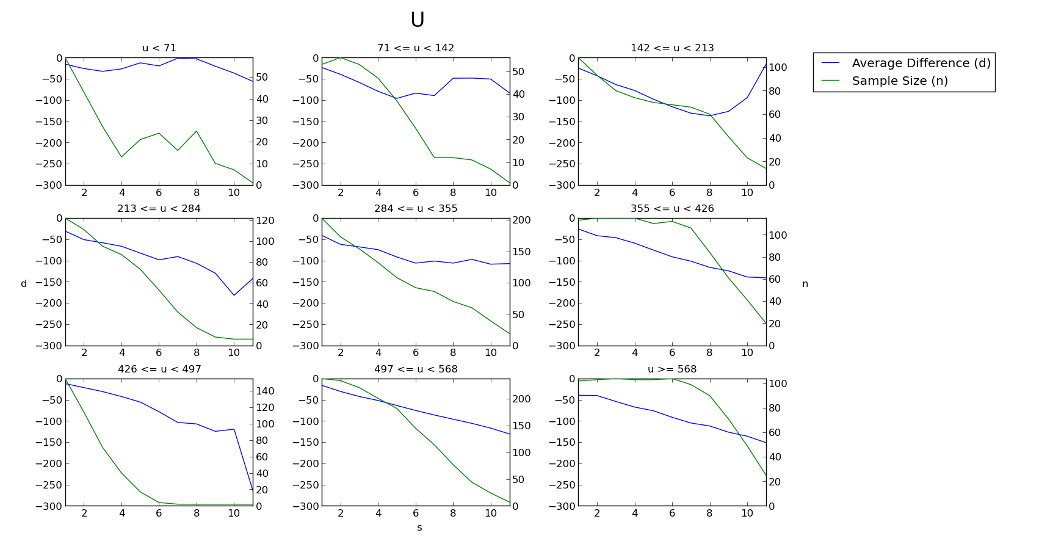
Statistical Analysis
Sideways movements

Slide 34
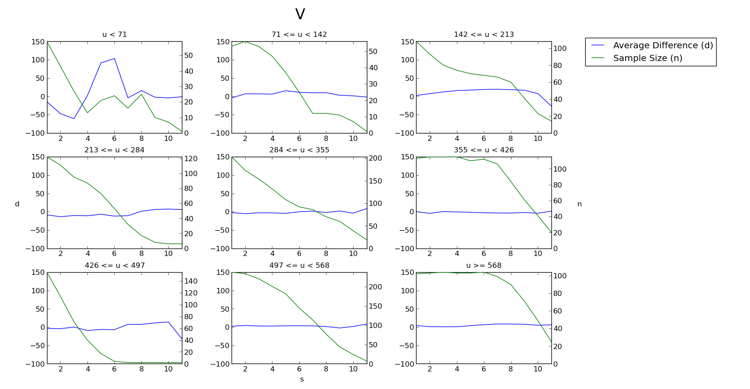
Statistical Analysis
Sideways movements

Slide 35
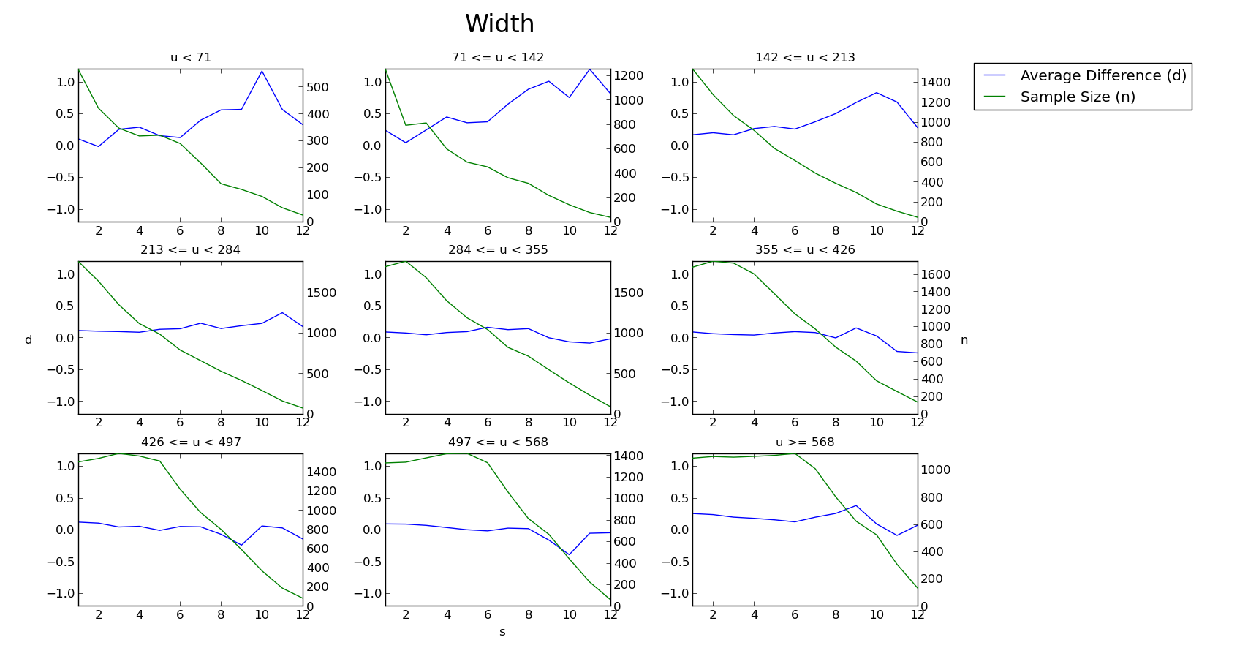
Statistical Analysis
Turning movements

Slide 36
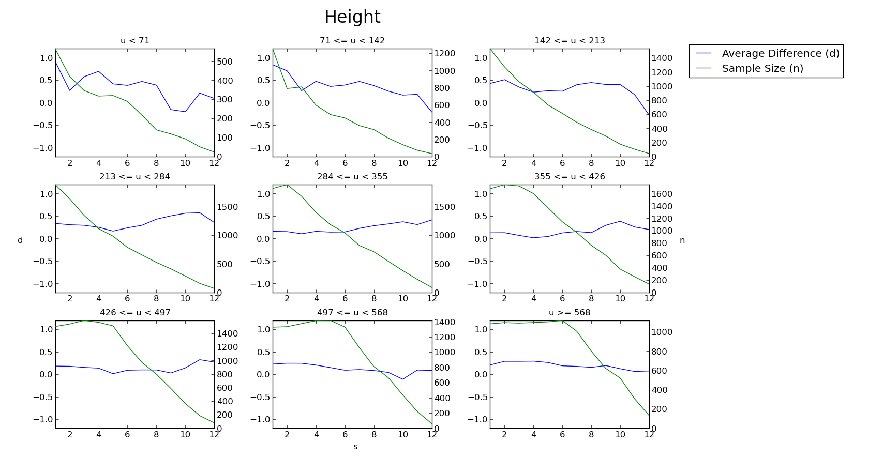
Statistical Analysis
Turning movements

Slide 37
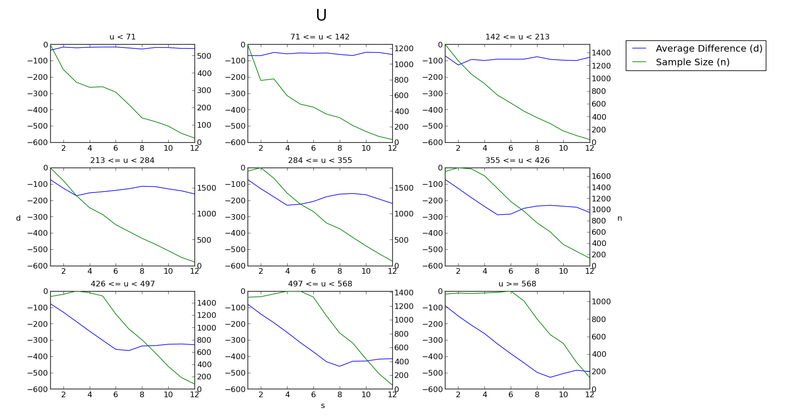
Statistical Analysis
Turning movements

Slide 38
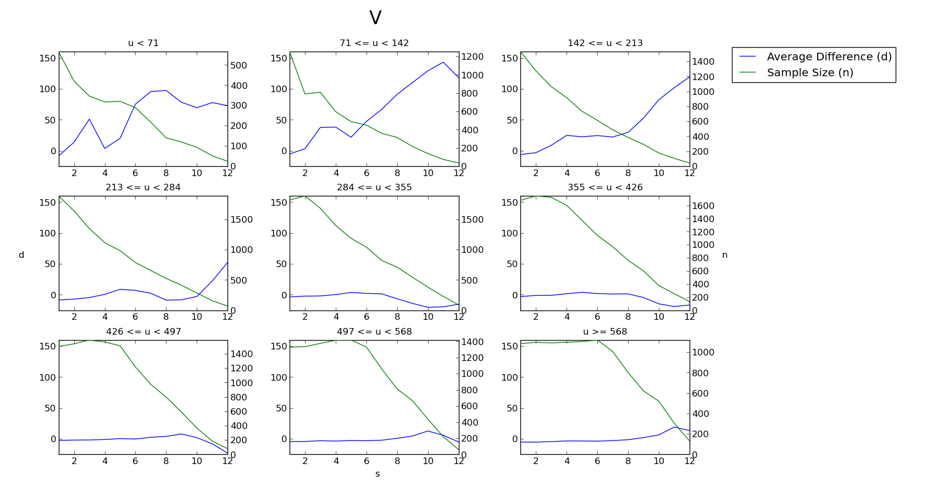
Statistical Analysis
Turning movements

Slide 39
Statistical Analysis
Relative differences
  Sideways movements: 10cm increments left-to-right
  Turning movements: 10° increments clockwise
Robot displacement X average change
  Horizontal position (U)

Slide 40
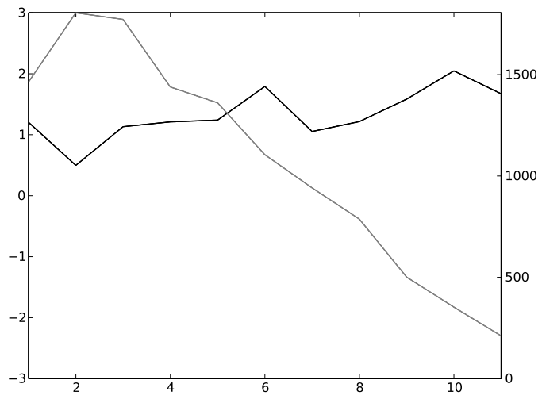
Statistical Analysis
Sideways movements

Slide 41
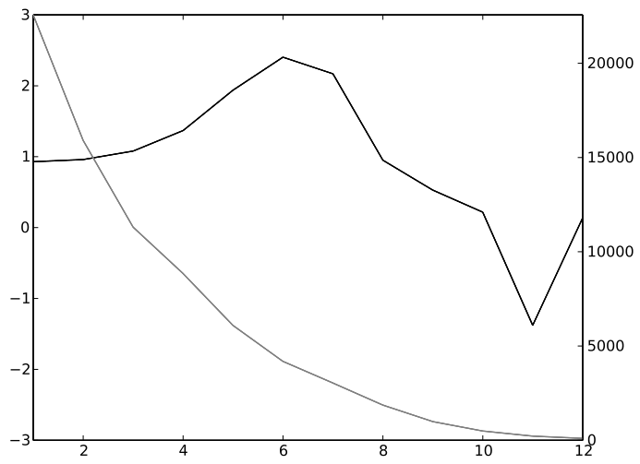
Statistical Analysis
Turning movements

Slide 42
Conclusions
Sighting dimensions (width, height) and horizontal positions correlate well to straight movements
Sighting horizontal positions correlate well to sideways and turning movements
Differences in relative changes can be exploited to tell apart sideways and turning movements
The feasibility of estimating robot displacement from landmark sighting changes is not be ruled out

Slide 43
Further Research
Methods for selecting landmarks
Larger / more varied image data base
Apply machine learning methods (e.g. WNN)
Application: visual navigation

Slide 44
Further Research
(x, y, θ)
Image
P1
=
S1
-
Sc
=
D1c
P1
WNN
P1
Pc
(Δx, Δy, Δθ)

Slide 45
The End
Source code, data files and article contents available at: http://github.com/xperroni/Yamabiko/tree/master/2013-3
Questions?

